Slide 1
STPA Applied to Radiotherapy First Steps and Lessons Learned
5th STAMP Workshop Reykjavik 2017
Wilko Verbakel
Marjan Admiraal
Natalia Silvis-Cividjian

Slide 2
Outline
Motivation
STPA theory: A simple example
STPA practice: Hazard analysis of a RT process
Results
Conclusions

Slide 3
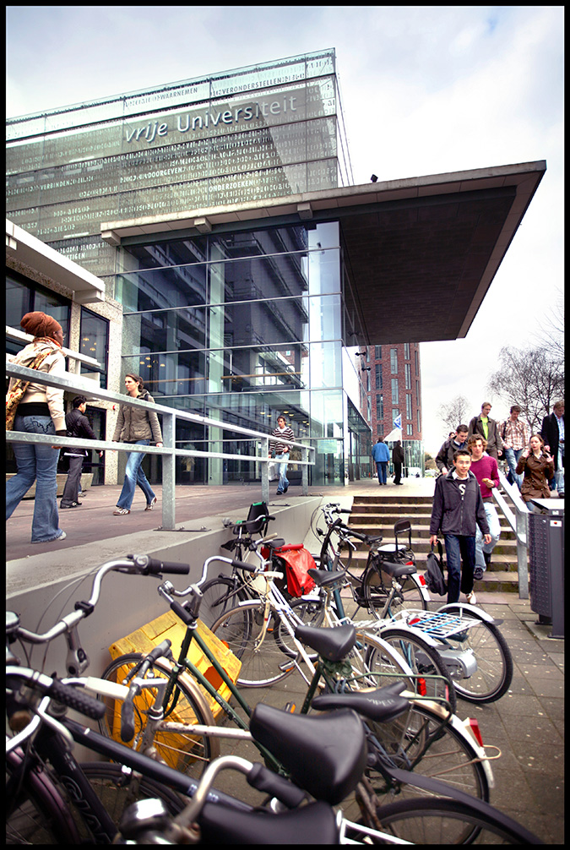
Who are we?
Natalia-computer engineer, lecturer at Vrije University, Computer Science dept.
Marjan & Wilko – medical physicists at VU medical center, Radiotherapy dept.

Slide 4
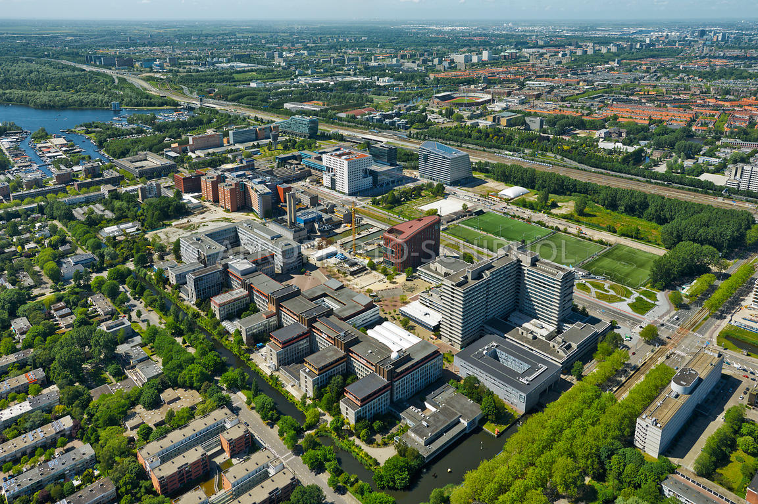
VU medical center
VU Computer Science dept

Slide 5
Motivation
We love STAMP ☺ (thanks to Nancy)
We teach STAMP
We wanted to try STAMP-STPA on a real safety-critical process

Slide 6
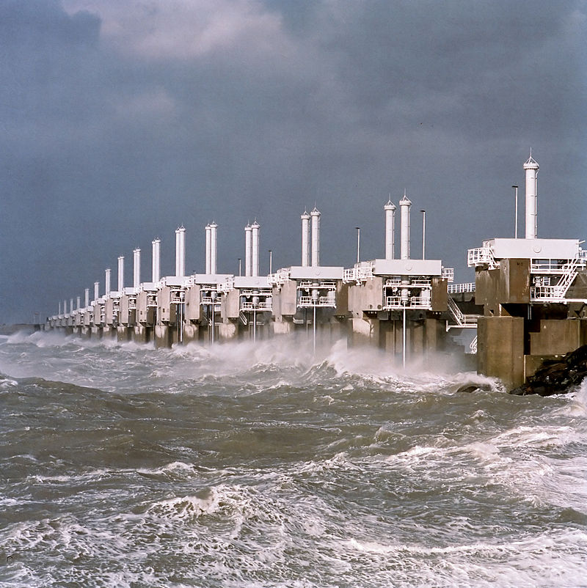
Oosterschelde storm surge barrier
Delta works
Open barrier, moveable sluice-type of gate doors
Close when water level is higher than 3m

Slide 7
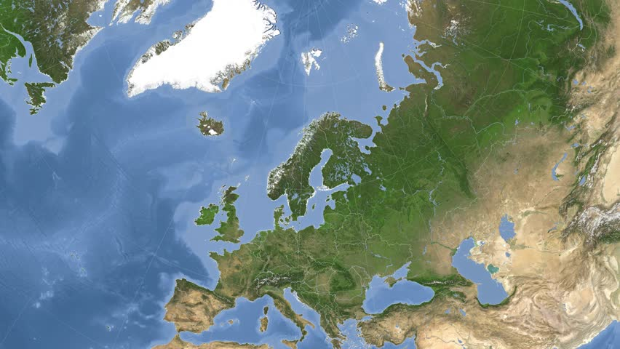
ICELAND
THE NETHERLANDS
5th STAMP workshop 2017 STPA-theory-simple-example

Slide 8
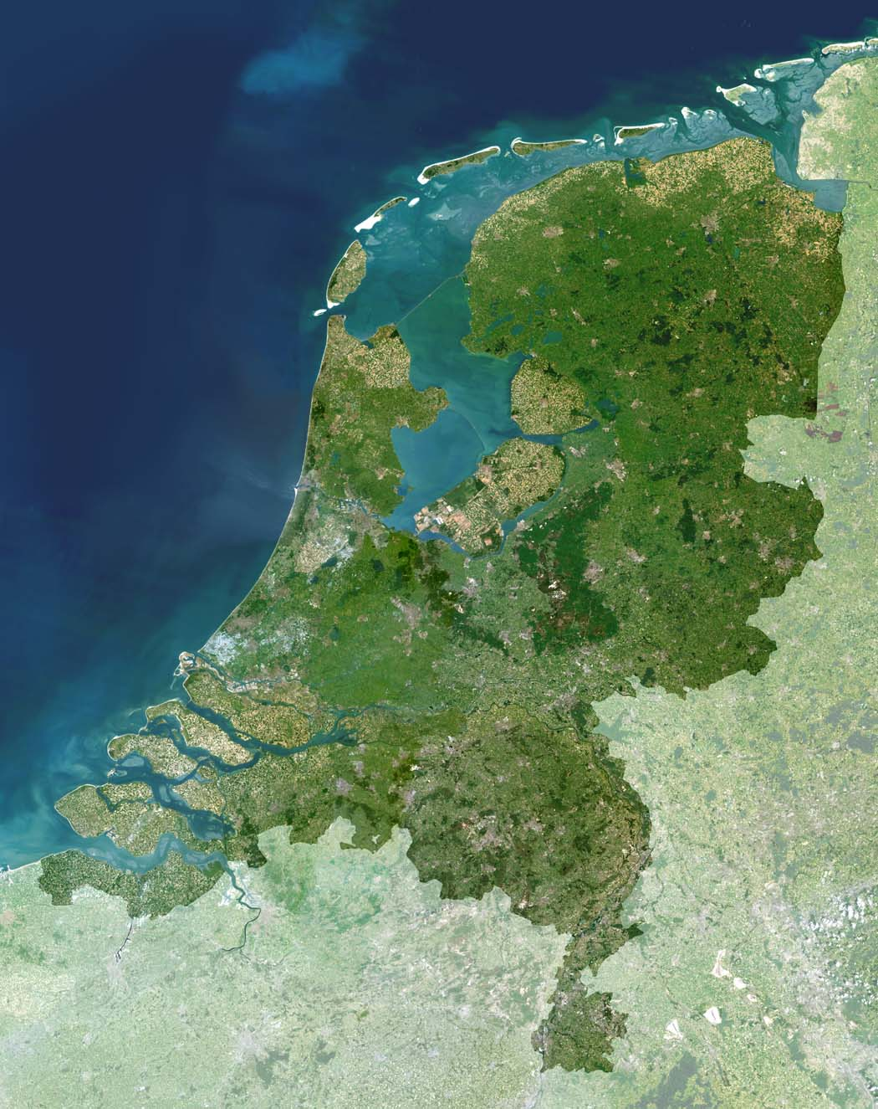
THE NETHERLANDS
DELTA WORKS
5th STAMP workshop 2017 STPA-theory-simple-example

Slide 9
5th STAMP workshop 2017 STPA-theory-simple-example

Slide 10
5th STAMP workshop 2017 STPA-theory-simple-example

Slide 11
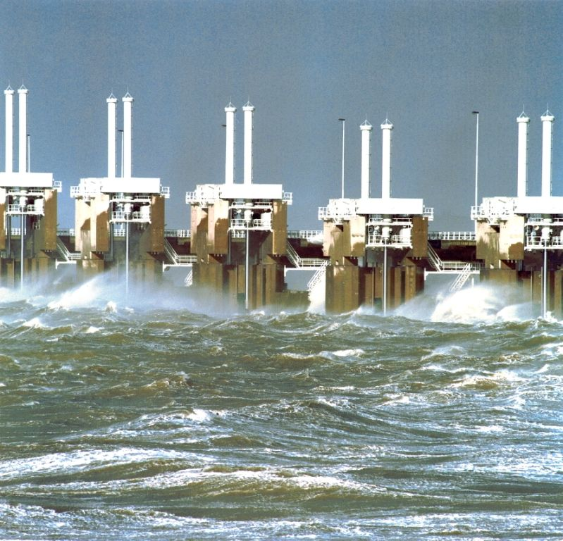
Sluice-type gate doors
closed
(Beeldbank Rijkswaterstaat)

Slide 12
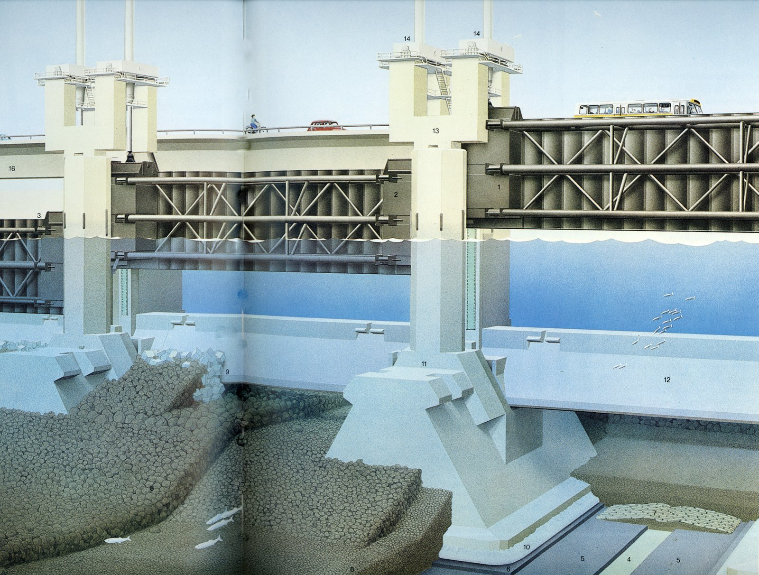
5th STAMP workshop 2017 STPA-theory-simple-example

Slide 13
Failure Mode and Effect Analysis (FMEA)
Courtesy of Jaap van Ekris

Slide 14
STPA High-level Accidents & Hazards
A1. People and animals die in a sea flood.
A2. Assets (houses, roads, bridges, cars, etc) are destroyed and lost in a sea flood.
A3. Salted water shellfish dies because the connection to the sea got closed.
H1. Doors do not close when water level > 3m (related to accidents A1 and A2)

Slide 15
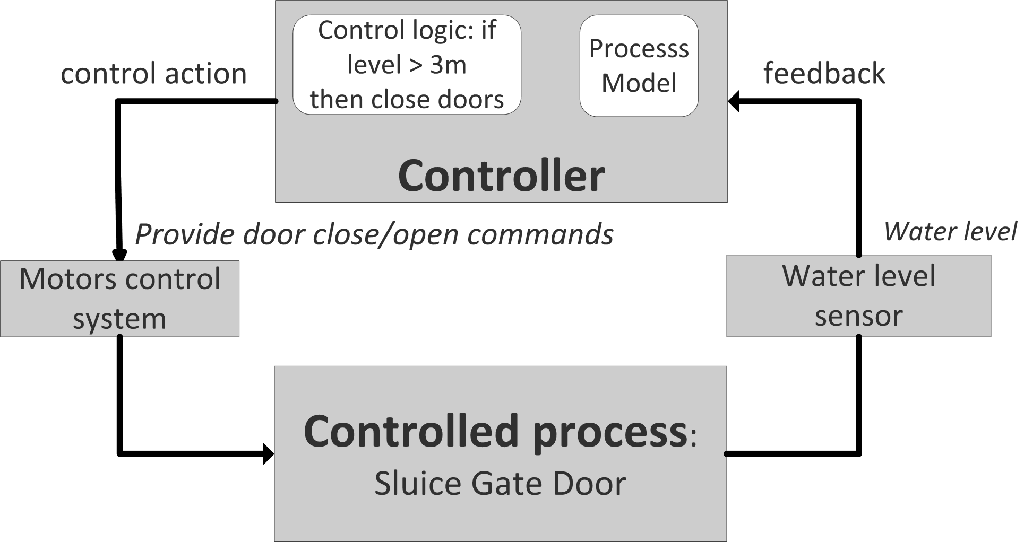
STPA Control structure
5th STAMP workshop 2017 STPA-theory-simple-example

Slide 16
STPA Step 1.Unsafe control actions
Control action (CA) | CA not given | Incorrect CA is given | CA is given at the wrong time or wrong order | CA is stopped too soon or applied too long
Provide door close/open command | Door close command is not given when level > 3m | Door open command is given when water level is >3m | Door close command given long after water has reached 3m and is rising Door open command much too late, long after the water level is safe | Door closed stopped too soon (door not completely closed) when level is > 3m

Slide 17
STPA Step2. Causal scenarios
The analyst asks Why? Which scenarios could lead to each UCA?
Example:
UCA: The water is 4 m high and the doors did not close. Why?
Possible reason: Water detector is defect.
Safety constraint: The decision to close should not rely on only one sensor.

Slide 18
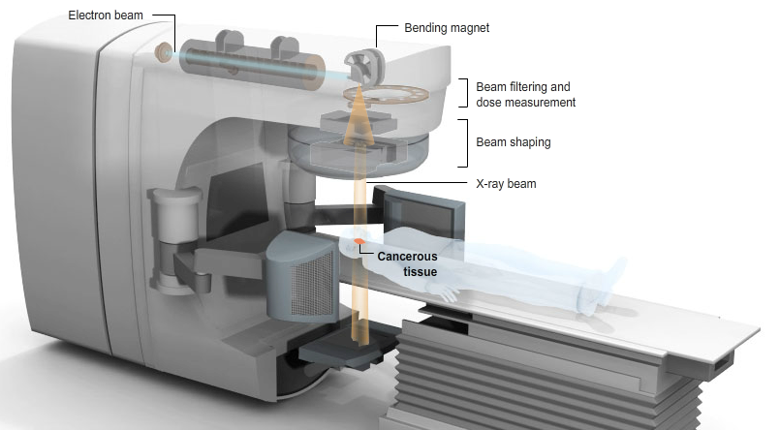
Intensity Modulated Radiation Therapy (IMRT)
Gantry
http://www.nytimes.com/interactive/2010/01/22/us/Radiation.html
5th STAMP workshop 2017 * STPA practice: hazard analysis of RT process

Slide 19
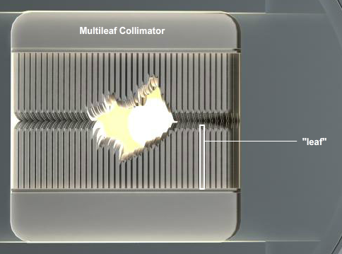
http://www.nytimes.com/interactive/2010/01/22/us/Radiation.html

Slide 20
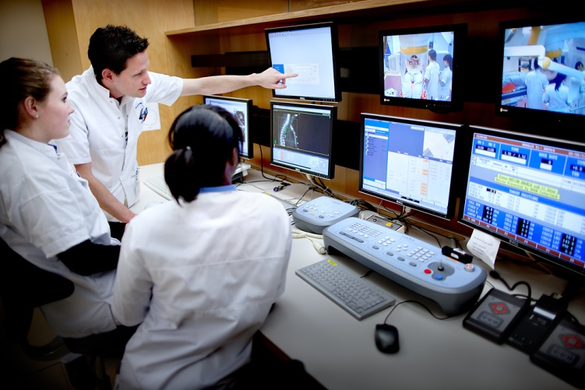
Dose distribution calculated by TPS
Video image from the linac room
Treatment plan
CT scan image

Slide 21
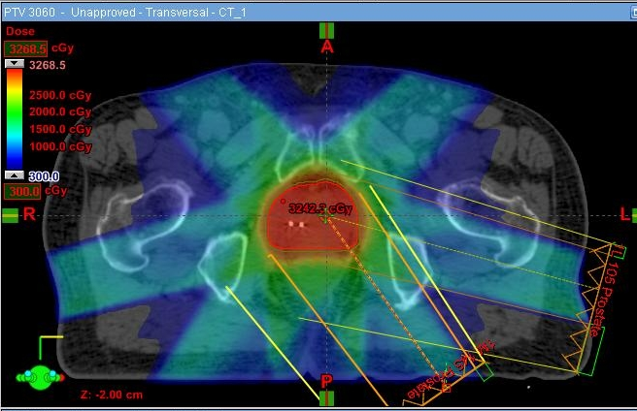
IMRT Treatment plan
http://acfro.com/what-to-expect-during-your-treatment/radiation-therapy-imrtigrt-oncology-physicial-therapy/

Slide 22
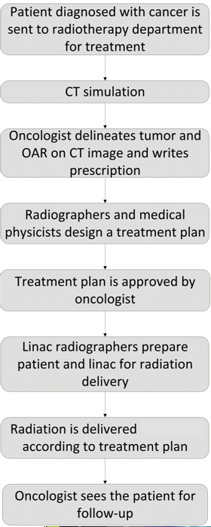
IMRT flowchart

Slide 23
Rationale
De facto hazard analysis methods in RT: (H)FMEA, FTA.
Both date from 50s, based on reliability theory. Humans and software are poorly predicted with probabilities! There is a need for new approaches.
STPA based on systems theory emerged recently.
A few STPA-RT studies already. No IMRT yet.
An STPA-IMRT experiment at VUmc

Slide 24
Research questions
RQ1.How difficult is it to apply STPA for hazard analysis in RT?
Can an outsider conduct it?
Will it add excesive workload for RT dept?
What to do with all the thousands of hazards we find?
Can we speed up by reusing artifacts from existing analyses?
RQ2. What is the added value of STPA vs HFMEA?
Compare STPA with an existing HFMEA

Slide 25
High-level accidents
A1. Patient injured or killed from radiation exposure
A2. A non-patient is injured or killed by radiation
A3. Damage or loss of equipment
A4. Physical damage to patient or non-patient during treatment (not from radiation)

Slide 26
High-level hazards
H1. Wrong radiation delivery to patient (linked to accident A1)
H1.1. Under-dose
H1.2 Over-dose
H1.3 Right dose but in a wrong fractioning
H1.4. Right dose to the wrong volume
H1.5. Wrong patient.
H2. A non patient (staff) is unnecessarily exposed to radiation (linked to accident A2)
H3. Persons are subject to non-radiological injury. (linked to accident A4)
H4. Equipment is subject to unnecessary stress. (linked to accident A3)

Slide 27
This is what the analyst is hearing:
CT operator positions the patient, takes CT images and saves them in ARIA
Oncologist writes a prescription in ARIA
Radiographer makes a plan and saves it in ARIA
Medical physicist reads the plan from ARIA and approves it
Post-planning radiographer annotates the approved plan and saves it in ARIA
Treatment delivery opens the plan in ARIA and delivers radiation accordingly
ARIA is a huge database shared by treatment planning and delivery
This is what the analyst is thinking:
Which level of granularity?
Who are the controllers?
What is a control action and what is a feedback?

Slide 28
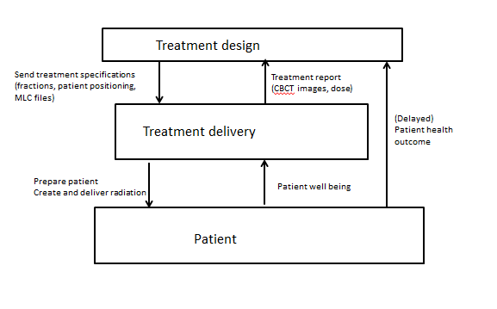
First high-level control structure
Hints: A control structure is not a description of the software or hardware architecture, but a representation of the functions that a system must perform and how these functions relate to each other. A controller is not always a person or a component, it is a functionality. STPA is a top-down approach

Slide 29
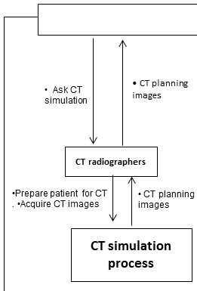
Hint: control actions are verbs, a kind of commands. Feedback is a noun, something that makes the controller adapt its process model.

Slide 30
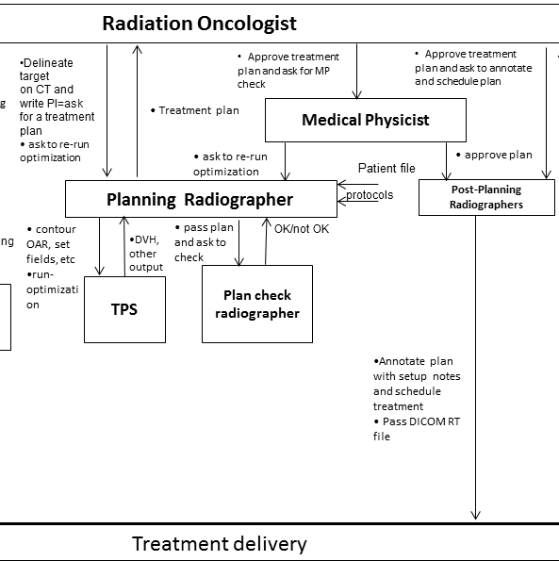

Slide 31
Control structure for Treatment Design controller

Slide 32
Control structure for Treatment Delivery controller

Slide 33
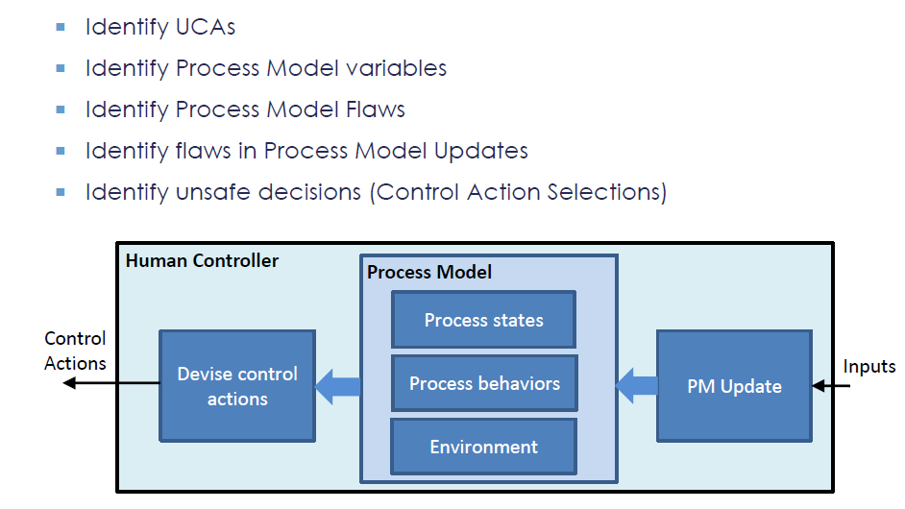
Extended STAP model for human controllers
[John Thomas, Megan France, MIT STAMP WORKSHOP 2016]

Slide 34
Example
Human controller: Planning radiographer
Control action: Run optimization in TPS
Control algorithm: Delineate OAR and position collimator on CT scan according to procedures and repeat run optimization in TPS until dose distribution is according to PI.

Slide 35
Causal scenarios
UCA: Planning radiographer stops optimization too soon. The plan has wrong parameters (collimator settings). WHY?
PI, protocols, feedback from peer reviewers, training, experience
the plan is good enough, so I stop optimization (and send it to oncologist)

Slide 36
Causal scenarios
(1) Incorrect belief of the process state.
PI or protocols are ambiguous and not clear
the radiographer thinks that his unorthodox way of collimator positioning is better, but he overlooks that radiation hot spots are created

Slide 37
Causal scenarios
(2) Incorrect belief of the process behavior.
radiographer is in hurry or was interrupted
the radiographer is not experienced. He could also ask questions to his superiors, but does not dare.
(3) Flaws in the mental model updates.
the radiographer used the same incorrect jaw positioning in previous plans without problems
he just wants some change and dares to try new things.

Slide 38
Research questions
RQ1.How difficult is it to apply STPA for hazard analysis in RT?
The begin is difficult
Can an outsider conduct it? YES
Will it add excesive workload for RT dept? NO
What to do with all the thousands of hazards? We found 140 UCAs. They should all be analyzed.
Can we speed up by reusing artifacts from existing analyses? YES, partially.

Slide 39
RQ2. What is the added value of STPA vs HFMEA?
Step1. Hazards identification
The lists of hazards overlap mostly.
FMEA is better in hazards of type wrong control action
STPA is more rigurous Ex: CT radiographer forgot to apply the tatoos (FMEA) vs. CT radiographer did not apply tatoos (STPA)
STPA found more hazards than FMEA
Ex: Postplanner sent the plan to delivery before it was approved and complete or The CT radiographers start to acquire images long after the patient has been immobilized on the table
Planning radiographer keeps on applying optimization in TPS even if peer reviewers already approved the plan. -> Interesting human behaviour

Slide 40
Step2. Causal scenarios
RQ2. What is the added value of STPA vs HFMEA?
STPA is more process oriented and does not necessarily hunt for human errors. STPA offers more guidance and shares the blame.

Slide 41
RQ2. Discussion
HFMEA is more detailed because STPA was performed by an outsider.
Some hazards were discarded by the team that performed the HFMEA, because: - Focus was different at that time - Hazards with low risk (probability of occurence, severity of consequences) were omitted - Knowledge of protection by procedures and software was incorporated in the evaluation of hazards

Slide 42
Conclusions
First attempt of STPA-IMRT in NL
STPA is most suitable for new RT processes/products
As educators we are feeling now more confident in STPA
Future work ideas: STPA for human behaviour in RT, STPA of new RT software
Efforts to promote STAMP for RT practioners & manufacturers and systems testers

Slide 43
Thanks to:
Todd Pawlicki (University of California, San Diego, US)
John Thomas (MIT, US)
Aubrey Samost (MIT, US)
Simon Whiteley (Whiteley Safety Engineering, UK)
Jaap van Ekris (Delta Pi, NL)
Robert de Boer (HvA, NL)
ESW-5 organizing committee

Slide 44
