Slide 1
Fortíð og framtíð
Reykjavik University
Heiðrún Lind Marteinsdóttir, framkvæmdastjóri SFS
Hrefna Karlsdóttir
Fisheries Iceland
March 10 2020

Slide 2
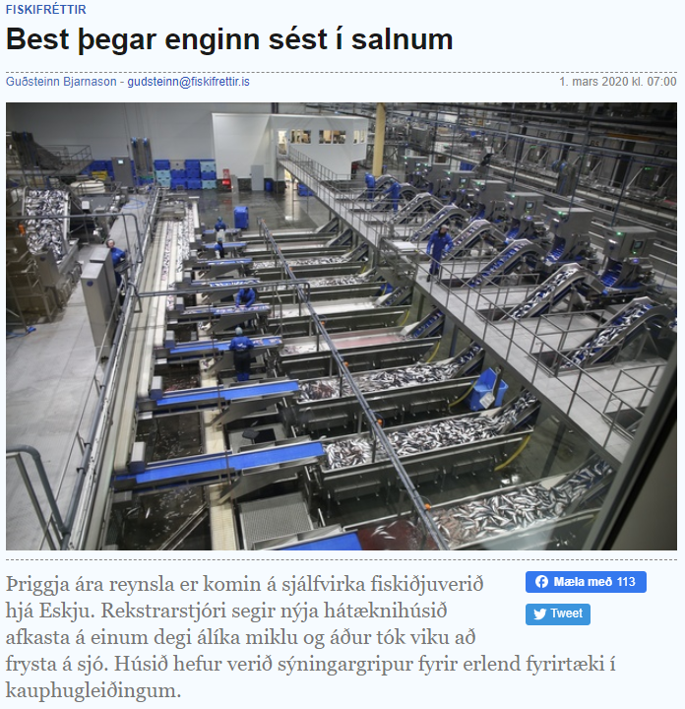
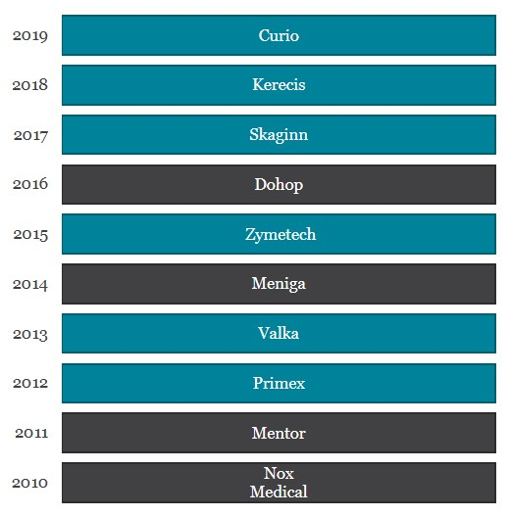
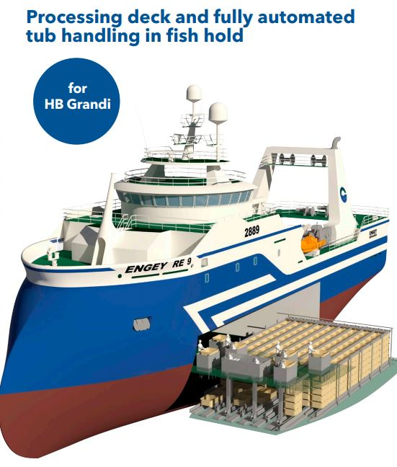
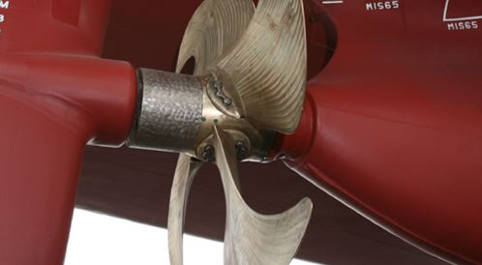
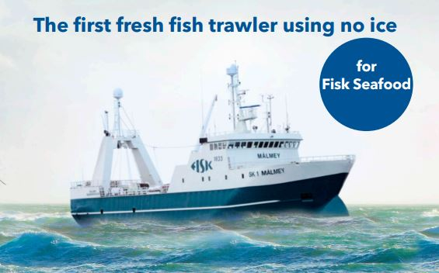
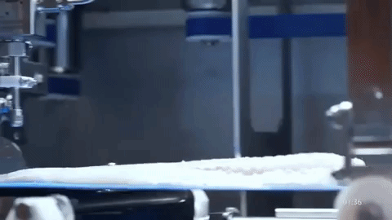
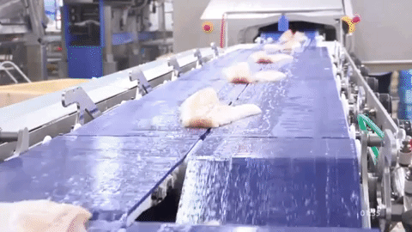

Slide 3
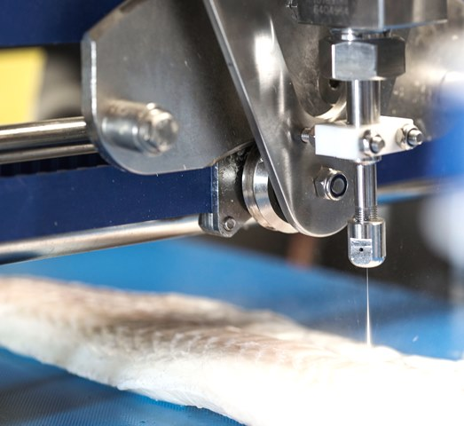
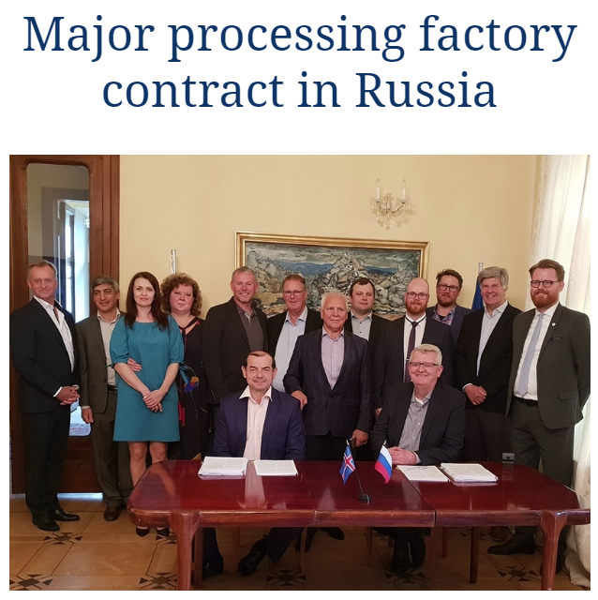
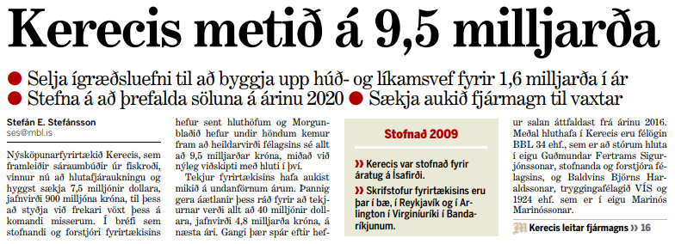
The Economic Impact of Fisheries Economy

Slide 4
Energy efficiency and the demand for environmental solutions on and off shore.

Slide 5
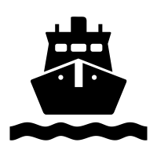
Logistics and operations - carbon footprint
Fisheries
Processing
Transport
Sales/market
Consumers

Slide 6
Aquaculture - Icelandic conditions
Adaptions of instruments and devices used in aquaculture in Iceland
Closed seapens in Iceland – challenges/solutions
Genetic introgression
Other mitigations

Slide 7
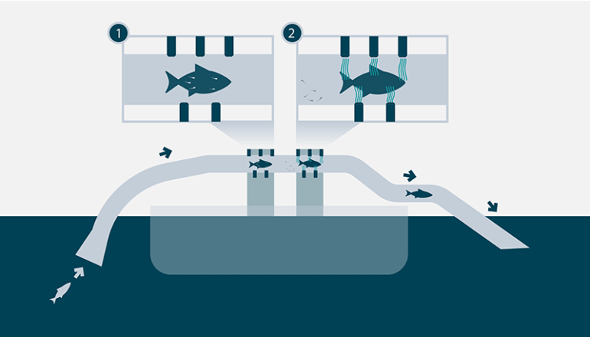
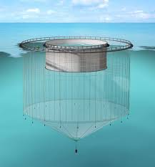
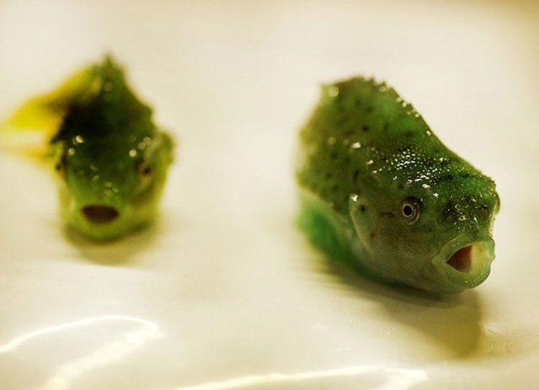
Aquaculture – salmon lice
Salmon lice – alternative control methods

Slide 8
https://mowi.com/blog/2020/03/03/mowi-collaborates-with-x-alphabets-innovation-engine-to-make-salmon-farming-more-sustainable/

