Slide 1
Isavia – Research Ideas
Hjalti Pálsson – Manager R&D

Slide 2





About isavia
Isavia (1st of January 2020)
  Isavia Air Navigation Services
  Isavia Regional Airports
  Tern Systems
  Duty Free
Operates all airports in Iceland
  Connecting different regions
  Connecting Iceland to Europe and USA
One of the largest ATC areas in the world

Slide 3

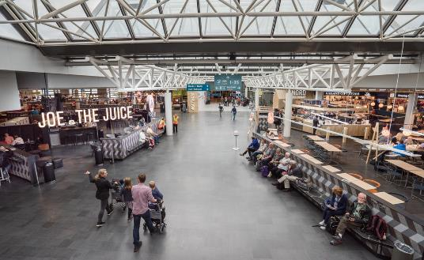
Keflavik International Airport
Convenient location on N-Atlantic and polar route
  Keflavik airport: 25 airlines and 80 destinations
Variety of facilities for all types of aircraft
  Two 3 km long runways
Busiest in the morning and afternoon – incentives to control the flow
Modern facilities – expansion under way

Slide 4
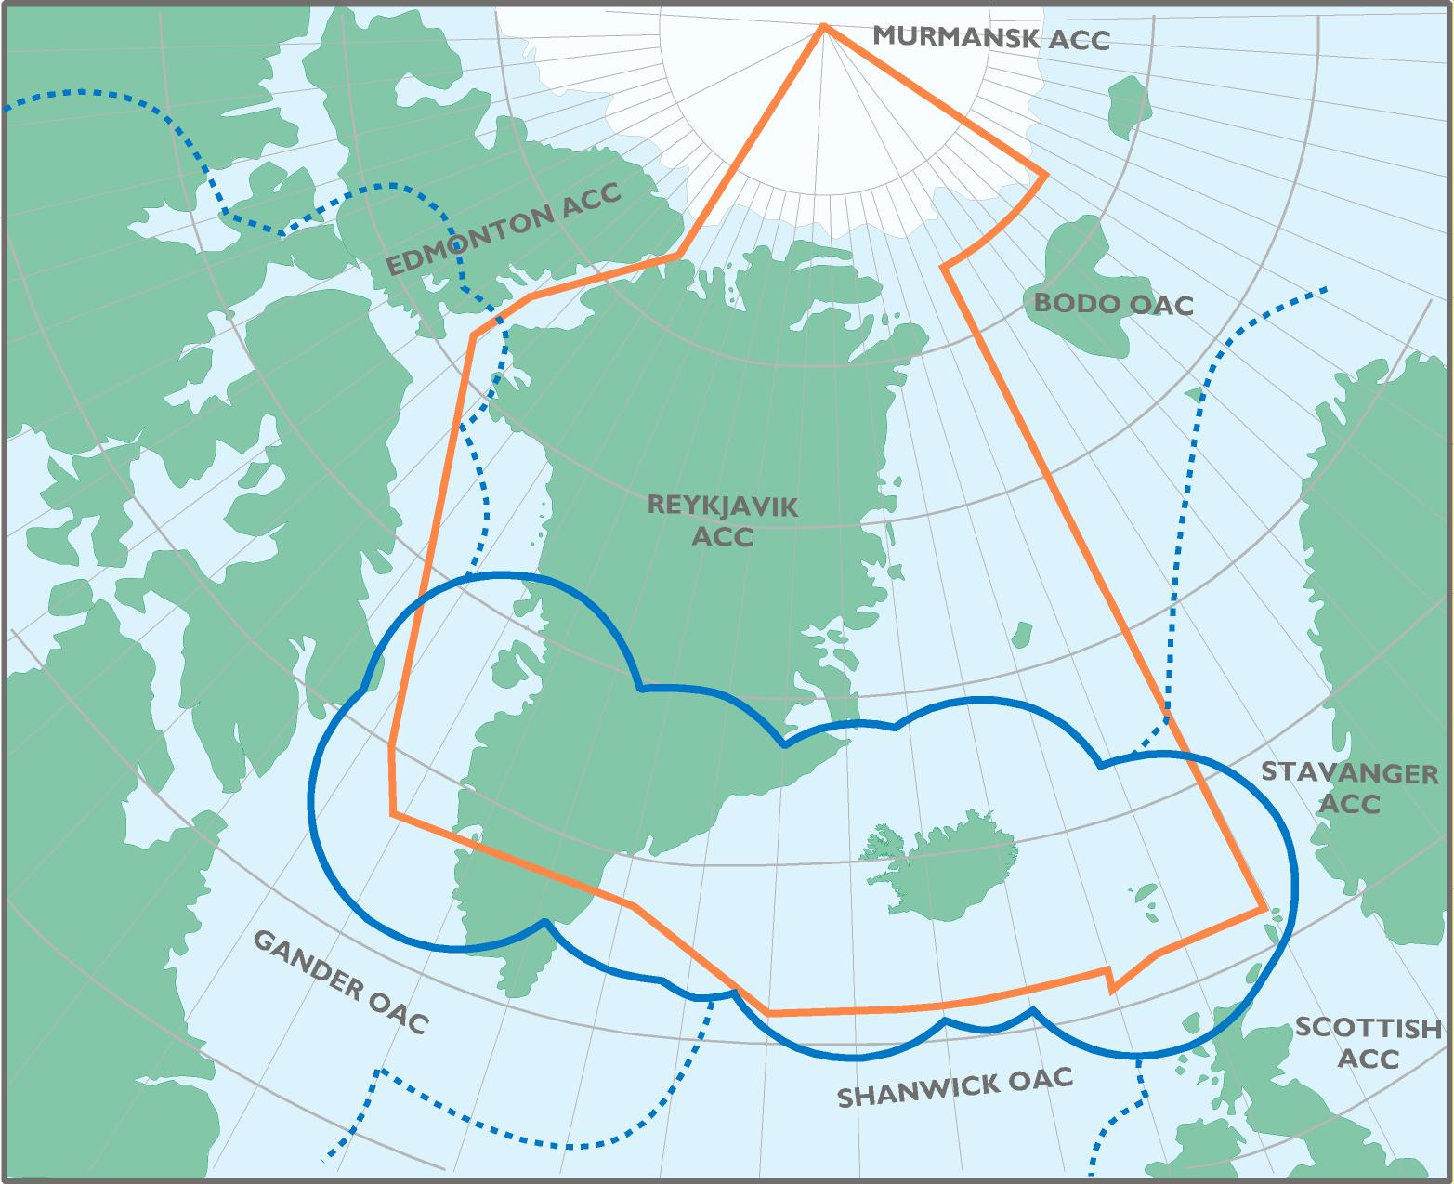
The reykjavik control area
5.4 million km²
No upper altitude limit
Approximately 25% of North-Atlantic air traffic
Exceptionally flexible routing and altitudes
An surveillance surveillance corridor connecting Europe and North-America

Slide 5
Project Ideas

Slide 6
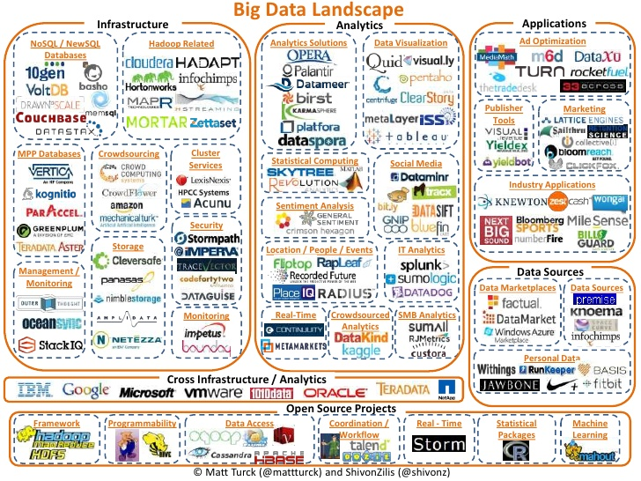
Data warehouse – Big Data Ecosystem
Data warehouse
  Developed by Tern Systems (https://www.tern.is/)
    MySQL, MariaDB, MyISAM
    3TB data, 7 billions surveillance reports, 10.5 million daily additions
  Flight Plan,
  Surveillance data (ADS-B, MLAT and System Track)
  Datalink
Big Data Ecosystem
  The next generation of Data Warehouse technology
  Extract Transform Load processes
  Apache Flume, Hadoop, Hbase, Spark and Atlas
  Snowflake, Azure, Amazon, Google, …

Slide 7
Keflavik Capacity projects – Focus Area
Wake Turbulence Separation for Keﬂavik International Airport Re-categorisation Requirements (RECAT-EU)
  Reykjavik University – June 2019
  Toma Emilov Tomov - Supervisors Þorgeir Pálsson and Ármann Gylfason
Data-Driven Predictive Analytics of Runway Occupancy Time for Improved capacity at Airports
  MIT International Center for Air Transportation – December 2019
  Nicolas Pierre Meijers - Supervisor R. John Hansman
Next steps
  Develop formal Keflavik Airport Capacity Model
  Time Based Separation (e.g. Heathrow)

Slide 8
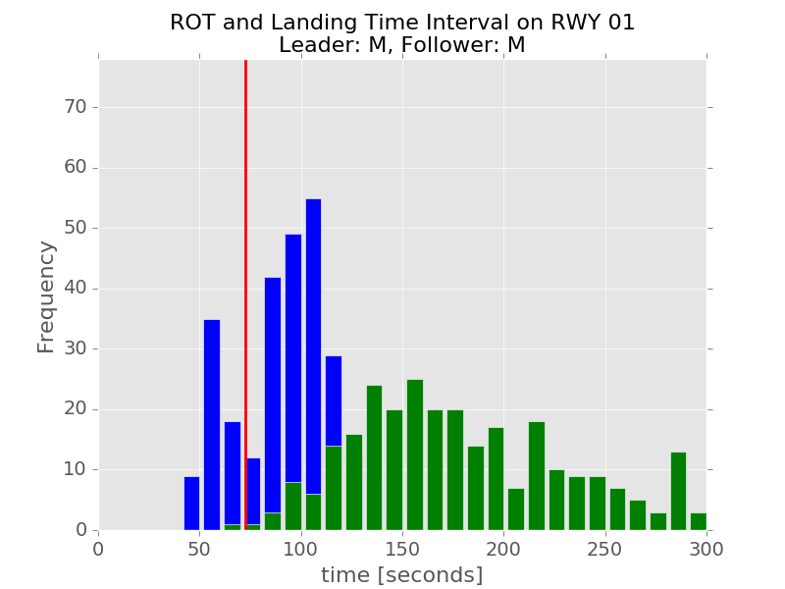
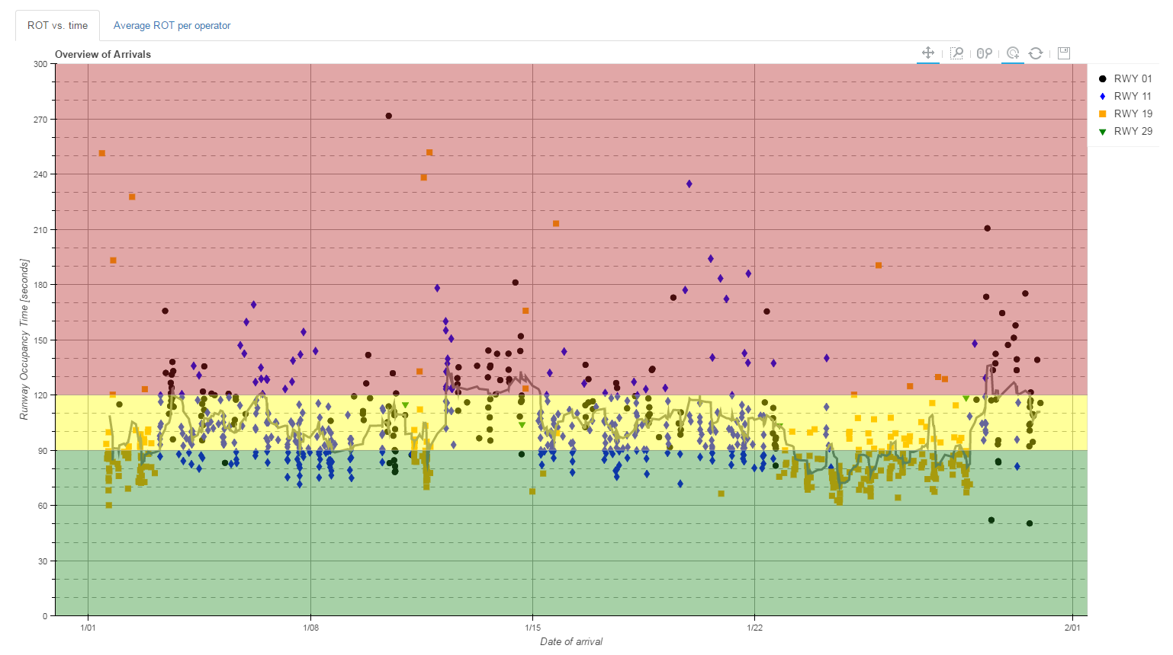
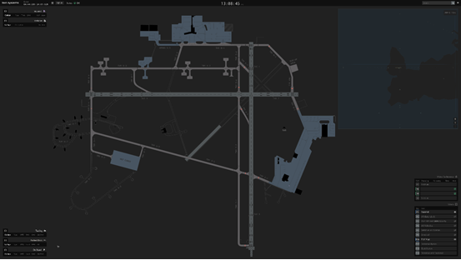
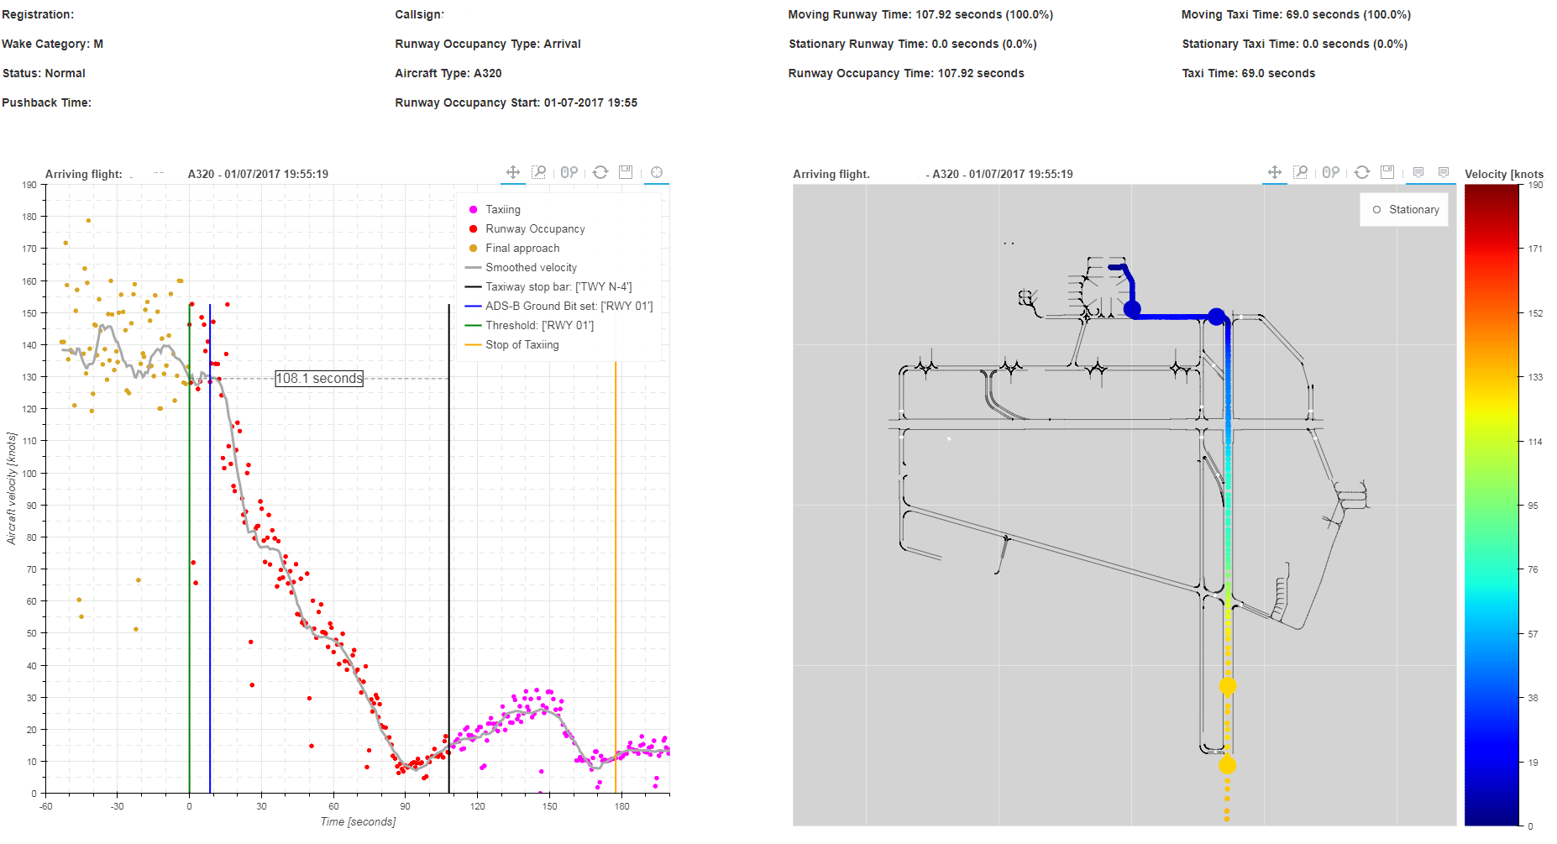
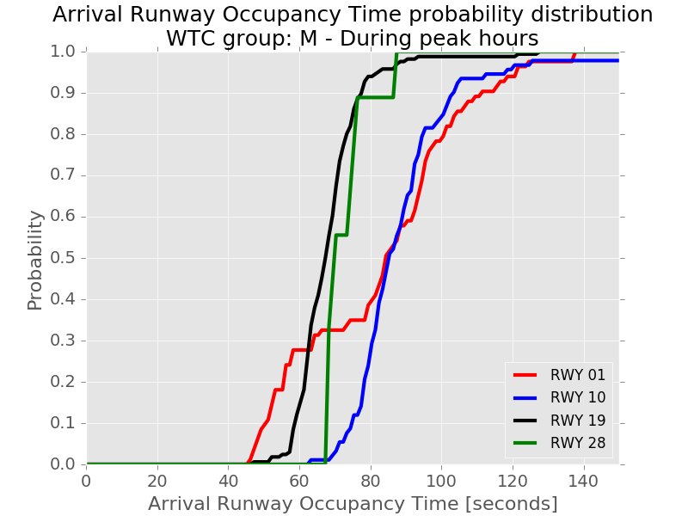
Keflavik Capacity measurements – Focus Area
The Data Warehouse has been aggregated with
  Runway Occupancy Time, taxi times, push back times,
  Separation on Final
  Runway Usage
  Peak hours
  Etc.
Unify the HMI
  Prototype
  Javascript - D3, https://d3js.org

Slide 9
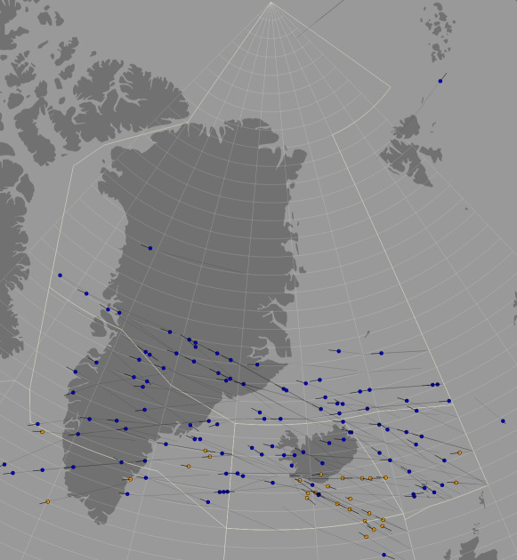
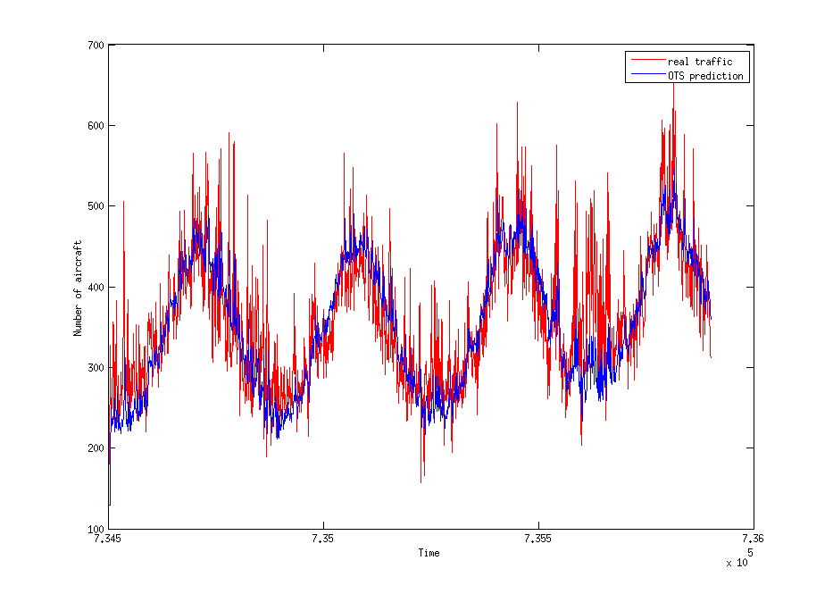
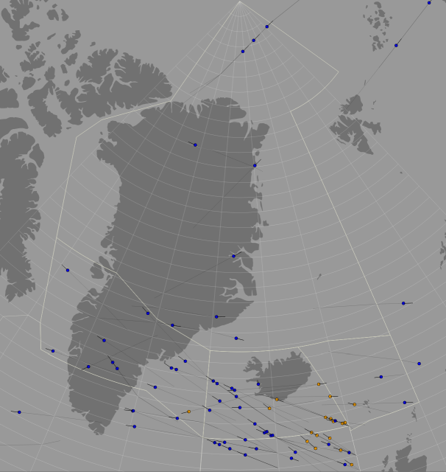
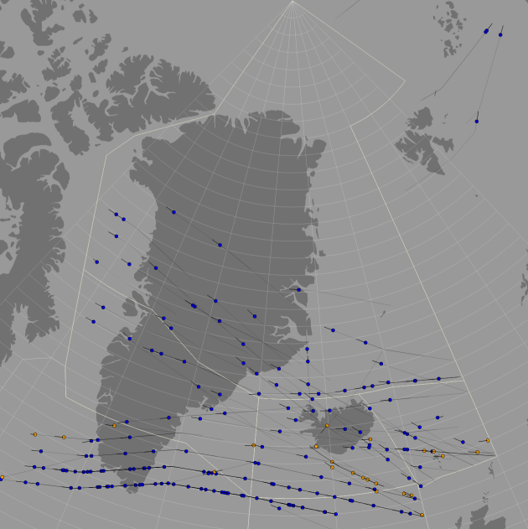
Air Traffic Flow Management – Focus Area
Air Traffic Forecast current model
  Time Series for next day
  Day, Night, Westbound, Eastbound and Domestic
Classic Artificial Intelligence
  Possible features:
    Prior days
    Flight Plans
    Weather data (Minimum Time Track)
  e.g. neural network problem
Air traffic forecast is used to optimize Air Traffic Controllers on duty

Slide 10
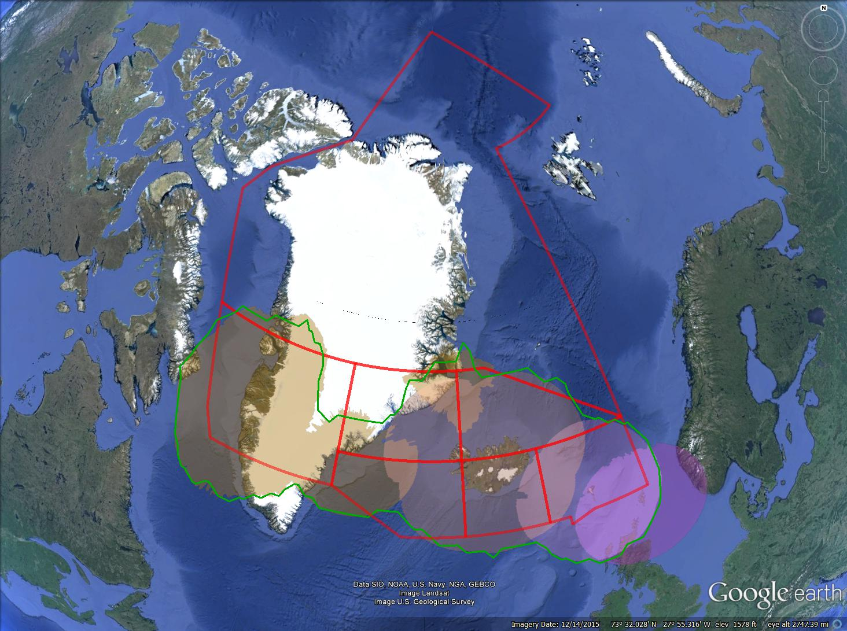
Airspace Complexity Measurement – Focus Area
Performance Metrics in Air Traffic Management Systems
  Reykjavik University – 2013
  Hulda Ástþórsdóttir – Supervisors Þorgeir Pálsson and Guðmundur J. Kristjánsson
Single complexity metric, depending on
  Aircraft count, Airspace volume
  Predicted conflict (number of, minute, angle).
  Altitude changes
  Altitude, Speed, Heading (mean, variance)
Complexity metric is useful in Air Traffic Flow Management decisions
  Both real time and in offline analysis

Slide 11
Automatic separation of aircraft
Automatic seperation of aircraft is the holy grail in air traffic management
  Literature study
  Problems of computational complexity
  Link to self separation of aircraft
    Drones
  Build up dataset for the research
    Current data is separated, possible to shift aircraft or change the separation
  Deploy different algorithms on Isavia‘s air traffic.
See also, ongoing project within Reykjavik University
  Enhanced Arrival Management System for Keflavik International Airport
  Professor: Þorgeir Pálsson

Slide 12

Shift optimization
Shift optimization for air traffic controllers
  Currently done regulary but no optimization tools available
Constraints
  Minimum Air Traffic Controllers allowed
  Yearly air traffic pattern
  Shift constraints

Slide 13
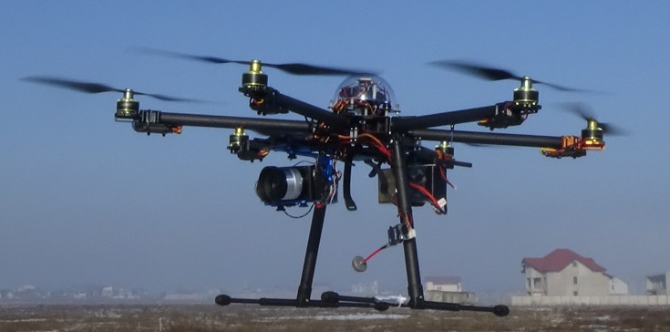
U-SPace
Drones are a growing business in Europe, delivering services in all environments, including urban areas.
Mapping, infrastructure inspections, precision agriculture, delivery of goods and e-commerce are just some of the
services possible using drones.
Two drones available,
  Operational tasks being investigated
    Flight inspections, PAPI lights
    Automatic
See also, ongoing project within Reykjavik University
  The Icelandic ATM Master Plan: Intergrating U-Space
  Professors: Gylfi Þ. Guðmundsson and Marcel Kyas

Slide 14
Earlier projects (27 projects since 2012)
Umsækjandi/leiðbeinandi | Titill verkefnis | Nemendur | Skemma
David Finger | Value of LIDAR data in enhancing aviation safety in Iceland | Yang Shu | Ólokið
Kristinn Þórisson og Þorgeir Pálsson | Towards safe trusted automation for air traffic control (“TrustWAI”)” | Jordi Bieger | Ólokið
Gylfi Þ. Guðmundsson og Marcel Kyas | The Icelandic ATM Master Plan: Intergrating U-Space | Not assigned yet
Þorgeir Pálsson og Ármann Gylfason | Aircraft Wake Vortex Seperation at Keflavík Airport | Toma Emilov Tomov | https://skemman.is/handle/1946/34042
Guðmundur Sigurðsson | Ábyrgð á tjóni vegna starfsemi Keflavíkurflugvallar | Ólafur V. Guðjónsson | https://skemman.is/handle/1946/31294
Hlynur Stefánsson | Optimisation of gate display times at Keflavík airport” | Guðmundur Karl Gautason | https://skemman.is/handle/1946/34904
Jón Guðnason, Kamilla Rún Jóhannsdóttir | Cognitive Workload Monitoring in Air Traffic Controllers | Eydís Huld Magnúsdóttir | https://opinvisindi.is/handle/20.500.11815/81/browse?authority=8a3c97b6-7a06-4dec-b2f4-f4f5c9e90089&type=author
Kristinn Þórisson og Þorgeir Pálsson | Towards safe trusted automation for air traffic control (“TrustWAI”)” | Jordi Bieger og Þór Tómasarson
Þórður Víkingur Friðgeirsson | Airport lounge | Sigurður Möller | https://skemman.is/handle/1946/26878
Páll Jensson og Þórður Víkingur Friðgeirsson | Financial assessment and risk analysis for airport parking investment | Anna Sigga Lúðvíksdóttir | https://skemman.is/handle/1946/26883
Páll Jensson og Þórður Víkingur Friðgeirsson | Airport hotel financial assessment and risk analysis | Hrönn Skaptadóttir | https://skemman.is/handle/1946/26884
Haraldur Sigþórsson | Viðhald á malbikuðum slitlögum | Sigurður Örnólfsson | https://skemman.is/handle/1946/23694
Valdimar Sigurðsson | Customer Experience Strategy | Bryndís Marteinsdóttir | https://skemman.is/handle/1946/25583
Arney Einarsdóttir | Knowledge Management | Hildur Baldvinssdóttir | https://skemman.is/handle/1946/25698
Páll Jensson, Þorgeir Pálsson | Norwegian model for financing the airport network | Sigríður Alma Gunnsteinsdóttir | https://skemman.is/handle/1946/25614
Páll Jensson, Þorgeir Pálsson, Eyjólfur Ingi Ásgeirsson | Wind Optimization of Flight Profiles through the Reykjavik Control Area | Ninna Björg Ólafsdóttir | https://skemman.is/handle/1946/19389
Hlynur Stefánsson, Bulent Özel, Þorgeir Pálsson | Agent Based Simulation for Passenger Demand for Air Transport in Iceland | Margrét Jóna Gestsdóttir | https://skemman.is/handle/1946/23798
Haraldur Sigþórsson | Útfærsla flughlaða við Keflavíkurflugvöll | Anna Berglind Sigurðardóttir | https://skemman.is/handle/1946/19392
Þorgeir Pálsson, Páll Jensson, Arnór Bergur Kristinsson | Reliability Analysis of the RVK Area Control Center Air Traffic Management System | Unnur Þórleifsdóttir | https://skemman.is/handle/1946/14014
Þorgeir Pálsson og Guðmundur Kristjánsson | Performance Metrics in Air Traffic Management Systems | Hulda Ástþórsdóttir | https://skemman.is/handle/1946/16134
Þorgeir Pálsson, Eyjólfur Ingi Ásgeirsson og Hjalti Pálsson | Lateral Optimization of Aircraft Tracks in Reykjavik Air Traffic Control Area | Einar Ingvi Andrésson | https://skemman.is/handle/1946/12682

Slide 15
Overview of Research Ideas
Contact - Hjalti Pálsson - hjalti.palsson@isavia.is
  Isavia is open for applications outside of the
Name | Problem statement | Domain
Data Warehouse – Big Data Ecosystem | The next generation of Data Warehouse technology | Software Engineering Computer Science
Keflavik Capacity Projects | Keflavik Airport Capacity Model Time Based Separation Prototype HMI | Engineering
Air Traffic Flow Management | Air Traffic Forecast Airspace Complexity Measure | Software Engineering Computer Science User Interface
Automatic Separation of Aircraft | Open research idea | Various
Shift optimization | Shift optimization for air traffic controllers | Industrial Engineering
U-Space | Open research idea | Various

