Slide 1
Icelandair Group | A Brief Introduction
Magnús Þorlákur Lúðvíksson, Business Development
magnus@icelandairgroup.is
February 2019

Slide 2
1
A brief introduction to Icelandair
2
Our partnership with Reykjavik Universiy
3
Q&A

Slide 3
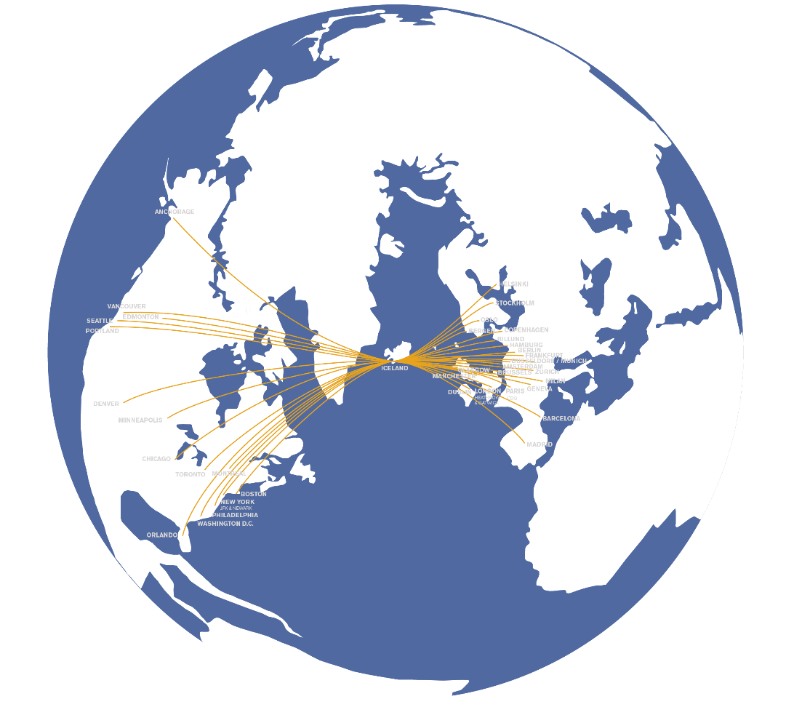
Icelandair Group at glance 2020
83 years in aviation
40 destinations
4.5 million passengers
380 connections
3,788 FTE´s
51 aircraft
Notes:
Strength and flexibility of the network is the heart of our business model. We are always looking at ways and exploring new destinations to grow and strengthen our network in a profitable way
We have the flexibility to focus the revenue generation and shift between TO-FROM-VIA. Via has been more challenging in recent quarters with high pressure on yields while we see more opportunities on the TO and FROM market
Our new revenue management system which we implemented this spring which is an O&D system (not a leg based system which we had previously) which helps us to maximize the revenue generation of the network
In our opinion there are exciting times ahead, we have made some changes to strengthen and align our operations with the current challenging environment and are prepared to seize the opportunities that lie ahead

Slide 4
Our other brands in aviation
Focuses on air-freight services in the holds of Icelandair’s passenger aircraft combined with scheduled air cargo flights
Operates extensive and flexible flight schedule in Iceland and the West Nordic countries
Offers capacity solutions to international passenger airlines and tour operators
An outgoing tour operator for leisure tourism and a specialized business travel agent

Slide 5
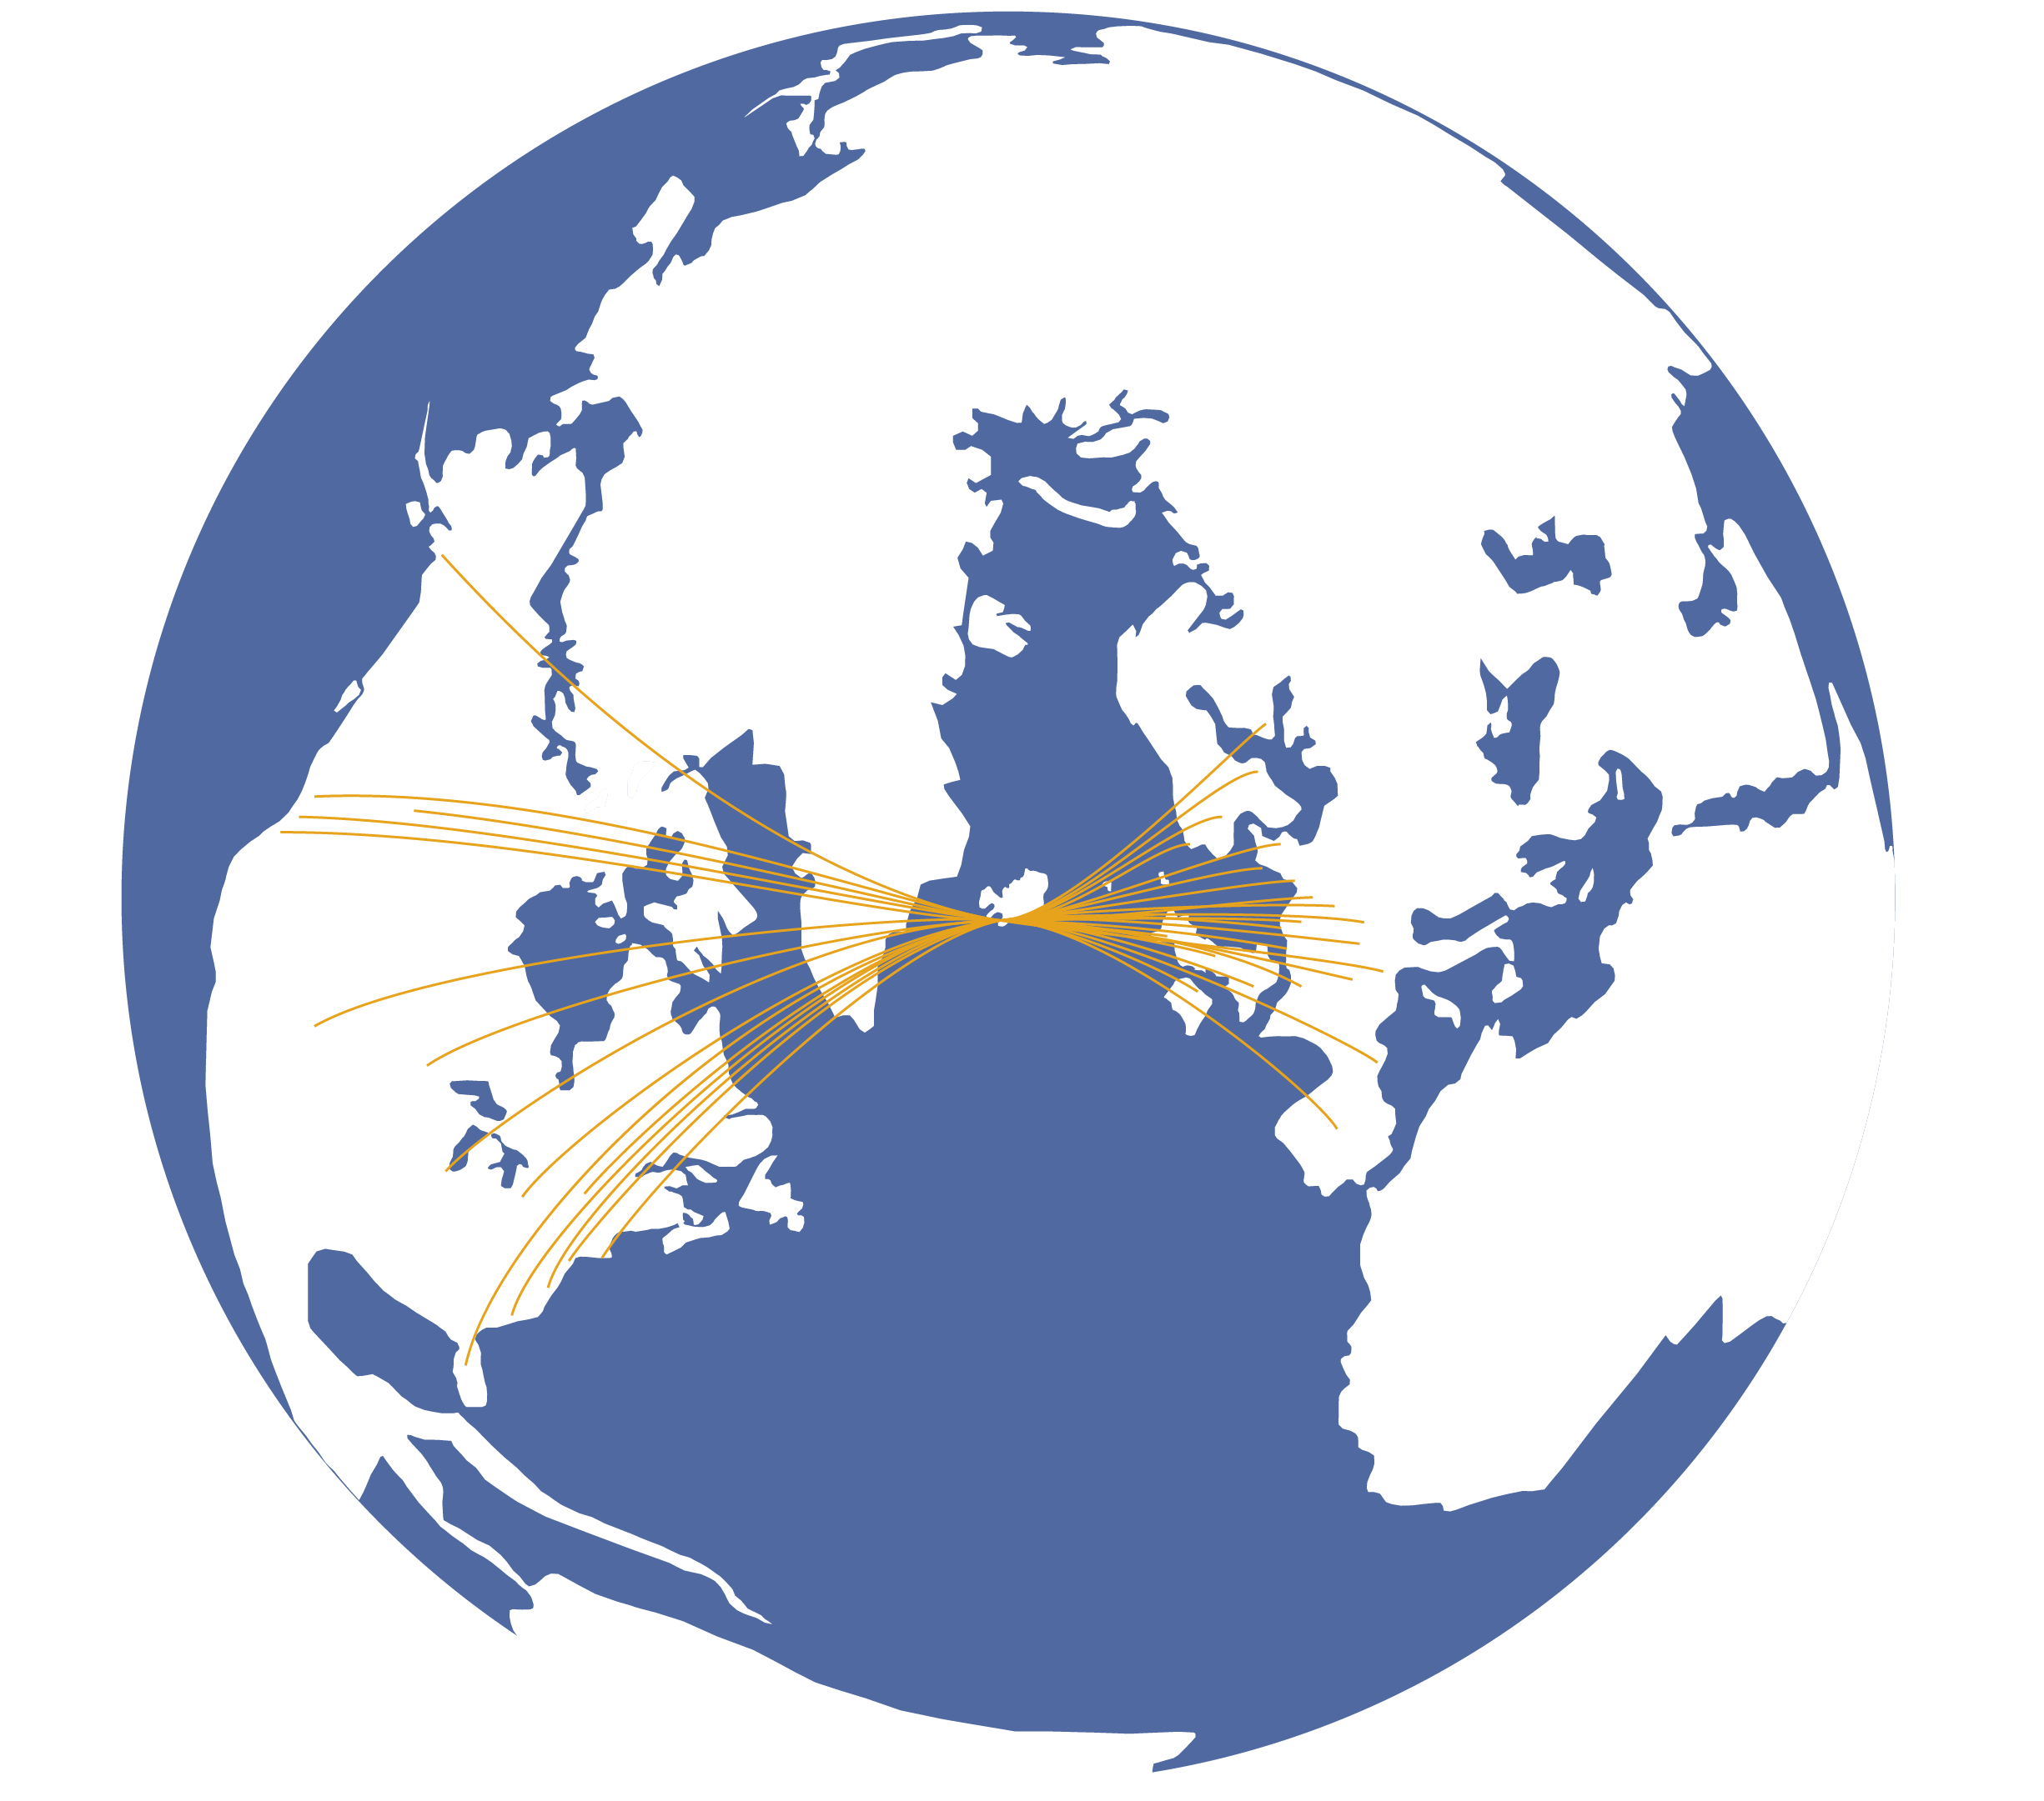
Iceland’s unique geographical position on the shortest flight-route between N-America and Europe is the key to Icelandair’s extensive 24 hour hub-and-spoke network

Slide 6
+114%
4,135
4,291
4,053
to
3,679
from
Icelandair has more than doubled in size since 2012. The airline serves three markets: TO Iceland, FROM Iceland and VIA Iceland
via
36%
36%
44%
3,073
38%
2,603
2,257
36%
12%
13%
2,005
36%
12%
15%
38%
15%
38%
16%
17%
52%
20%
50%
51%
49%
41%
45%
48%
42%
2012
2013
2014
2015
2016
2017
2018
2019
Notes:
Kemur 3.janúar – farþegatölurnar verða í fréttatilkynningu 6.jan man

Slide 7
1
A brief introduction to Icelandair
2
Our partnership with Reykjavik Universiy
3
Q&A

Slide 8
Icelandair Group and Reykjavik University partnership
In recent years, a number of graduate students at Reykjavik University have written their final thesis in co-operation with Icelandair Group
This means that the students choose a subject related to Icelandair Group’s area of expertise and are supported practically and financially by the company during its writing
Graduate students that are interested need to apply to be a part of the program and a group composed of university and company representatives will choose which projects to back

Slide 9
RU graduate students are free to propose the thesis topics they wish – we have also collected a few proposals that students can build on if they want (1/2)
Icelandair thesis topic proposals 2020/21
Subject
Proposal
Description
Computer Science
Website visitor segmentation
We would like to segment the visitors to Icelandair websites based on behavior. From where do visitors arrive? What parts of the website to they spend time on? Which book a flight and which don't? What is their past behavior if they are returning customers?
1
Law
Predatory pricing in the aviation market
A review of predatory pricing in the aviation markets, especially in the context of Hæstiréttur’s ruling no. 205/2011 and in comparison to case law in the EU
2
Market abuse regulation
A review into the effects of the implementation of market abuse regulation No 596/2014 (MAR) into Icelandic law on issuers of financial instruments
3
Buying and leasing aircraft
A comparison of the different arrangements used when buying and leasing aircraft
4
Personal data collection laws
Icelandair is moving towards a more personalized service, where the customer experience is shaped by who the customer is and past behavior. We would be interested in an analysis of how the EU's data protection rules (Regulation 2016/679 and Directive 2016/680) will affect the use of customer data when developing digital solutions
5

Slide 10
RU graduate students are free to propose the thesis topics they wish – we have also collected a few proposals that students can build on if they want (2/2)
Icelandair Group thesis topic proposals 2019/2020
Subject
Proposal
Description
Engineering and sciences
Reliability analysis of flight controls and hydraulics
Analysis of the reliability of flight controls and hydraulics in Icelandair’s aircraft. The analysis would include looking at the frequency of malfunctions, the type of maintenance required and the cost of said maintenance. The analysis would also include looking at which parts are the most important drivers of malfunctions and maintenance costs, and to generate proposals for how to change protocols to increase reliability. Analysis could for example be focused on rotary actuators
6
Damage to aircraft pressurized structure
Damage to aircraft pressurized structure results in costly repairs. This research would use commonly available materials such as aluminum sheets and aircraft sealants to develop a temporary repair to unstiffened sections of the fuselage
7
Stress on aircraft antenna installations
Finite element modelling and crack growth analysis of a typical antenna installation on a Boeing 757 fuselage. Research of stress build up in antenna build up area and comparison with traditional mechanical approach and damage tolerance analysis
8

Slide 11
1
A brief introduction to Icelandair
2
Our partnership with Reykjavik Universiy
3
Q&A

Slide 12
Questions and answers
Q&A

